Slide 1
Maths Mastery in Foundation 2
“Mastering maths means pupils acquiring a deep, long-term, secure and adaptable understanding of the subject.”
The National Centre for Excellence in the Teaching of Mathematics
Notes:
Wirral and Cheshire Maths Hub – all EYFS staff have received training on using the mastery approach to delivermaths
What is Mastery? – not about “can they do it?” it is about “how deep is their understanding?”
We want children to gain a deep understanding of maths – secure and long term knowledge which will allow them to make continual progress as they move onto more complex topics
At the core of this approach s the belief that everyone can do maths – there is no such thing as a “maths person”
We want children to have the self-belief that they can do maths
We are teaching by breaking down maths objectives into the smallest steps so that every pupil is secure in every new concept before moving on – it is about moving slowly to connect children’s natural knowledge with more formal “maths”

Slide 2
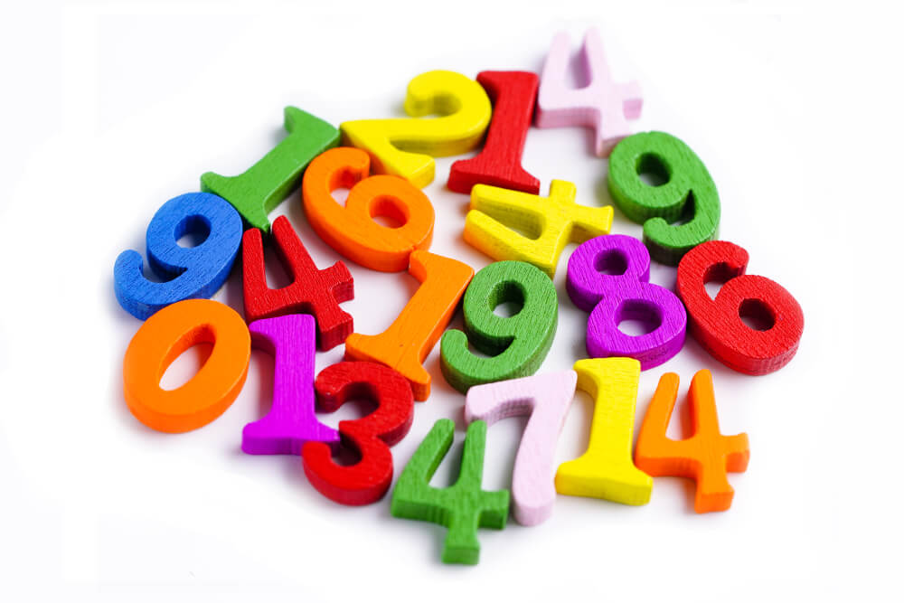
Maths Mastery in Foundation 2
We are working with the Wirral and Cheshire Maths Hub to deliver maths in F2 using the mastery approach.
At the core of this approach is the belief that everyone can “do” maths and we want children to have the self-belief that they can achieve in maths.
By learning through maths mastery, children gain secure and long-term knowledge which allows them to make continual progress as they move onto more complex topics.
We teach by breaking down maths objectives into the smallest steps so that every child is secure in each new concept before moving on.
The aim is to connect children’s natural knowledge with more formal maths learning.

Slide 3
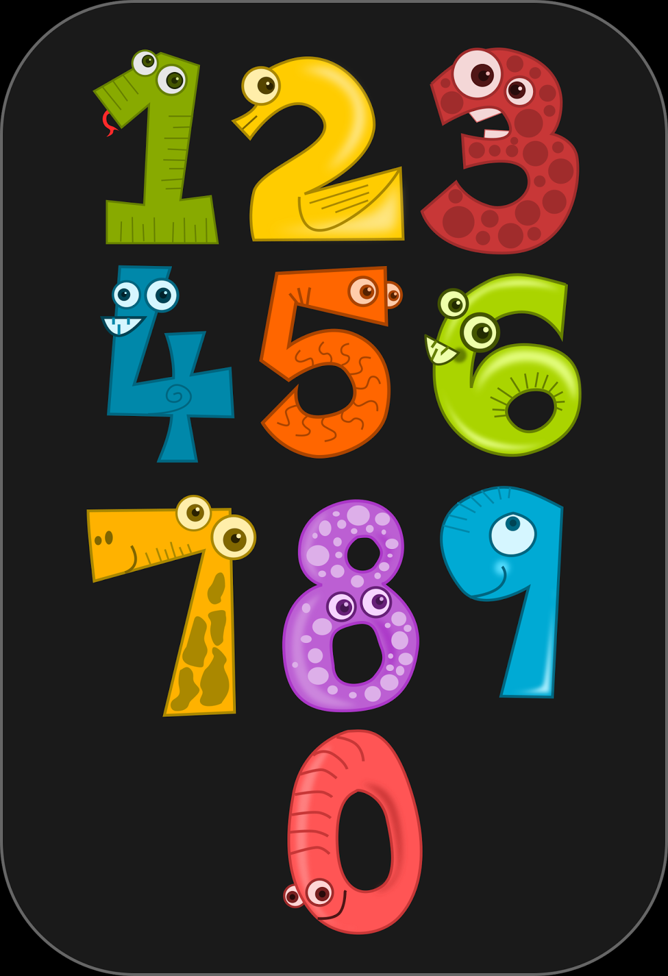
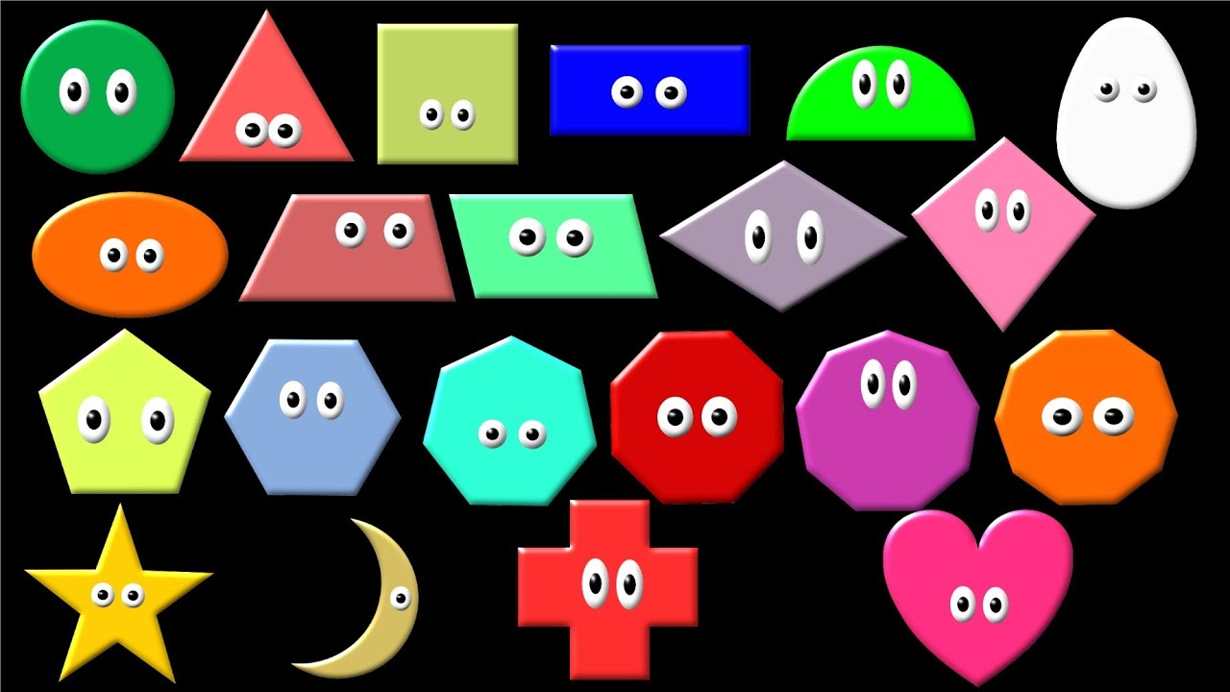
EYFS Early Learning Goals
Numbers:
Children count reliably with numbers from one to 20, place them in order and say which number is one more or one less than a given number. Using quantities and objects, they add and subtract two single-digit numbers and count on or back to find the answer. They solve problems, including doubling, halving and sharing.
Shape, Space and Measures:
Children use everyday language to talk about size, weight, capacity, position, distance, time and money to compare quantities and objects and to solve problems. They recognise, create and describe patterns. They explore characteristics of everyday objects and shapes and use mathematical language to describe them.
Even though we are using the mastery approach, we still have to ensure we are covering all aspects of the maths EYFS Early Learning Goals – this is the expected standard for children at the end of Foundation 2.
However, teaching for maths mastery uses a holistic approach. We used to teach number and shape, space and measures in separate blocks. Now all aspects of maths are interwoven.

Slide 4
The 7 Big Ideas in EYFS Mathematics
Problem Solving
Pattern
Comparison
Number Operations
Measurement
Shape & Space
Cardinality & Counting
These are the 7 core areas of mathematics and when we are thinking about the children’s progression in Maths through F2, we are doing so using these “Big Ideas”.
As you can see in this diagram, problem solving is the key concept that overarches all the others and it is a thread that runs throughout all the other areas. The children have plenty of opportunities to problem solve throughout the week and much of the teaching of new ideas and concepts is done using a problem solving approach.
The questioning and the language we use with the children plays an important part in this. Questions such as “How do you know?” and “Is it possible?” promote mathematical thinking. We try hard not to just say “well done” when a child answers something correctly but we instead use “That’s interesting. Can you tell me a bit more about why you think that?”
Research shows that children being able to think about and articulate their own thinking makes them more successful learners

Slide 5
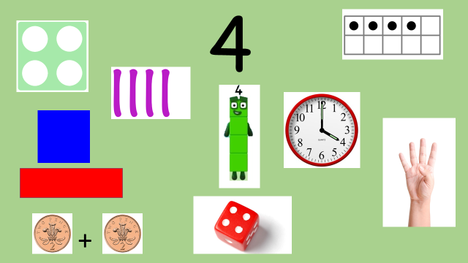
One number at a time …
At the beginning, we focus on one number at time.
When introducing each number we start with looking at all the different ways that number can be represented .
We want to develop children’s sense of number so that they have a deeper understanding of the number rather than just recognising the numeral.
Then we move onto looking at those 7 big ideas from the previous slide and teach them through that number.

Slide 6
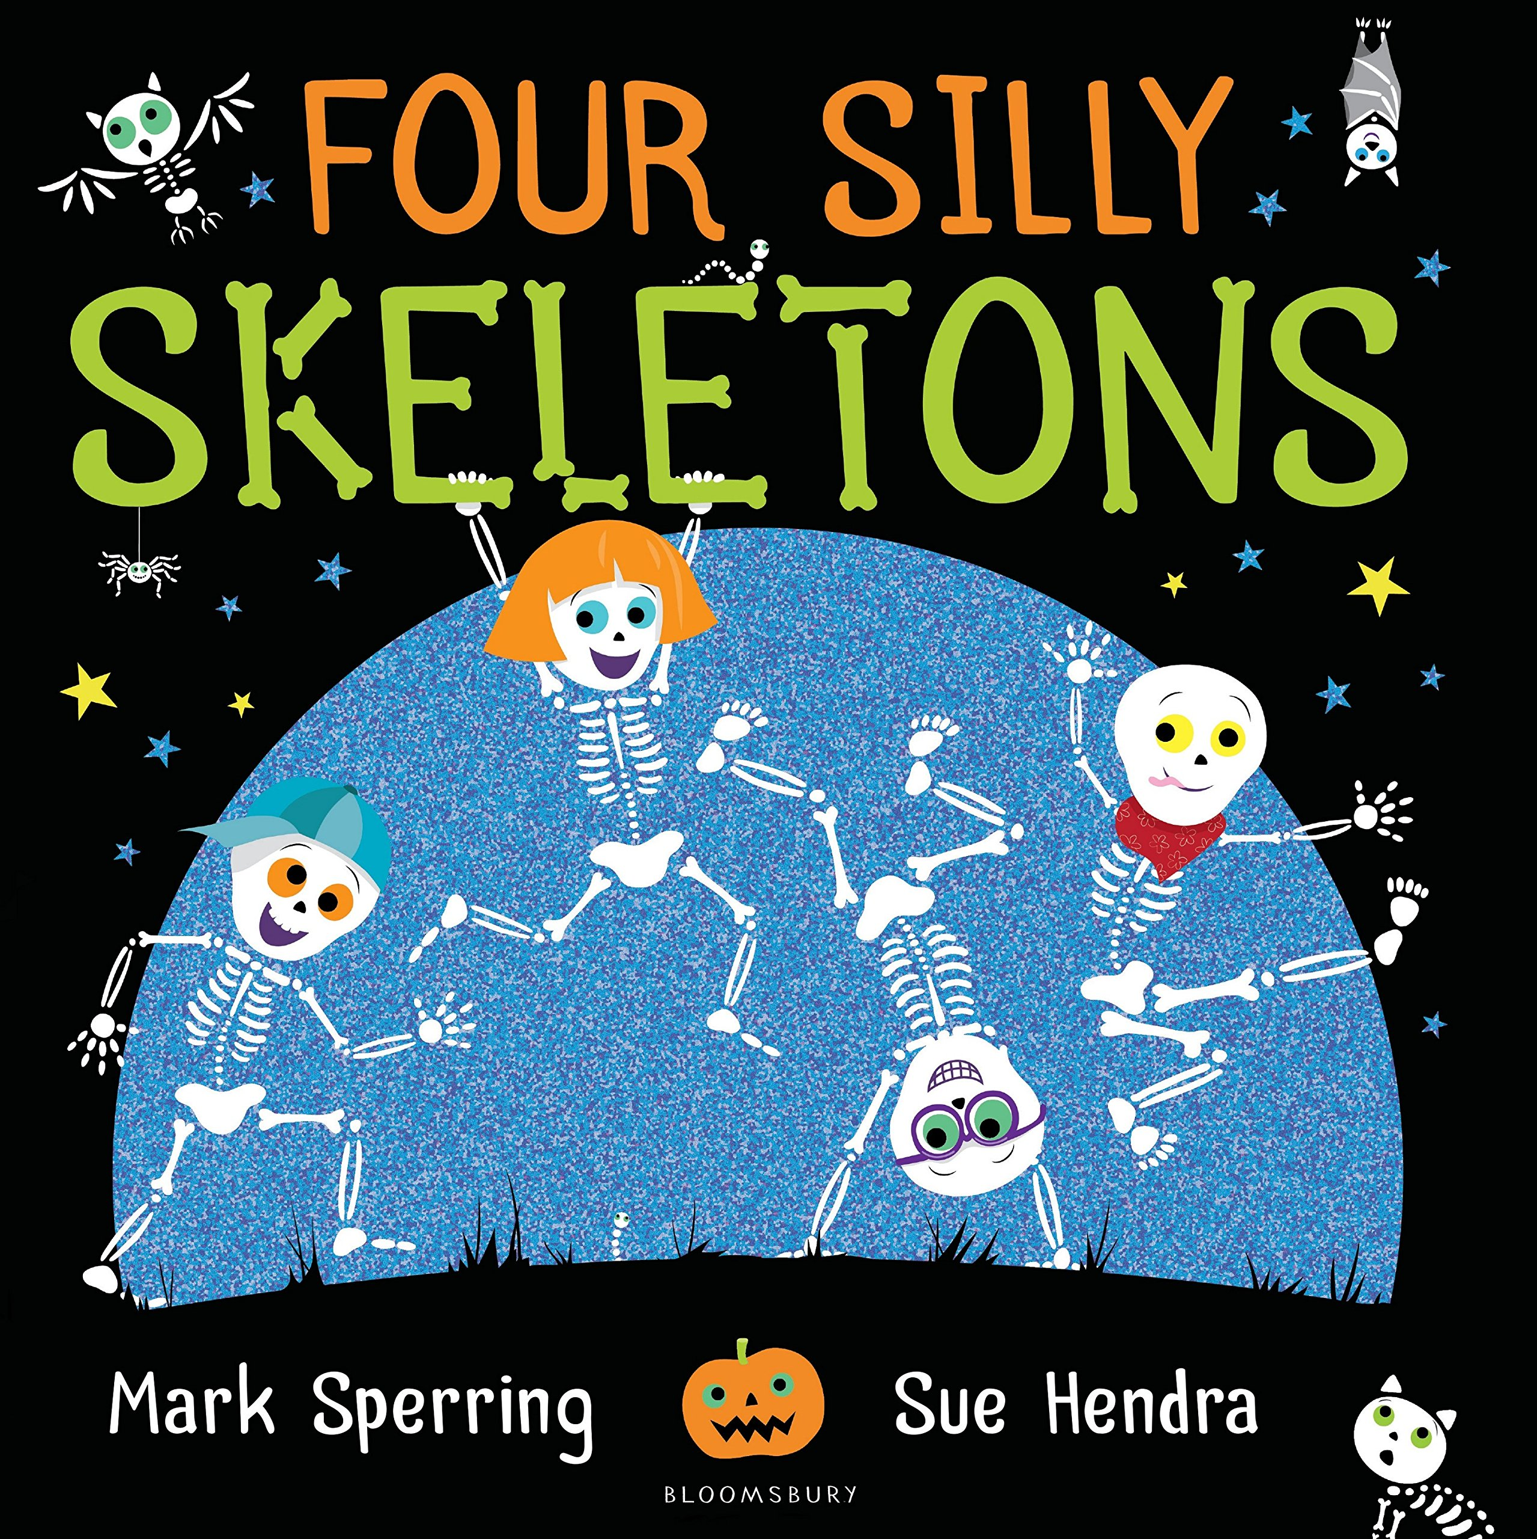
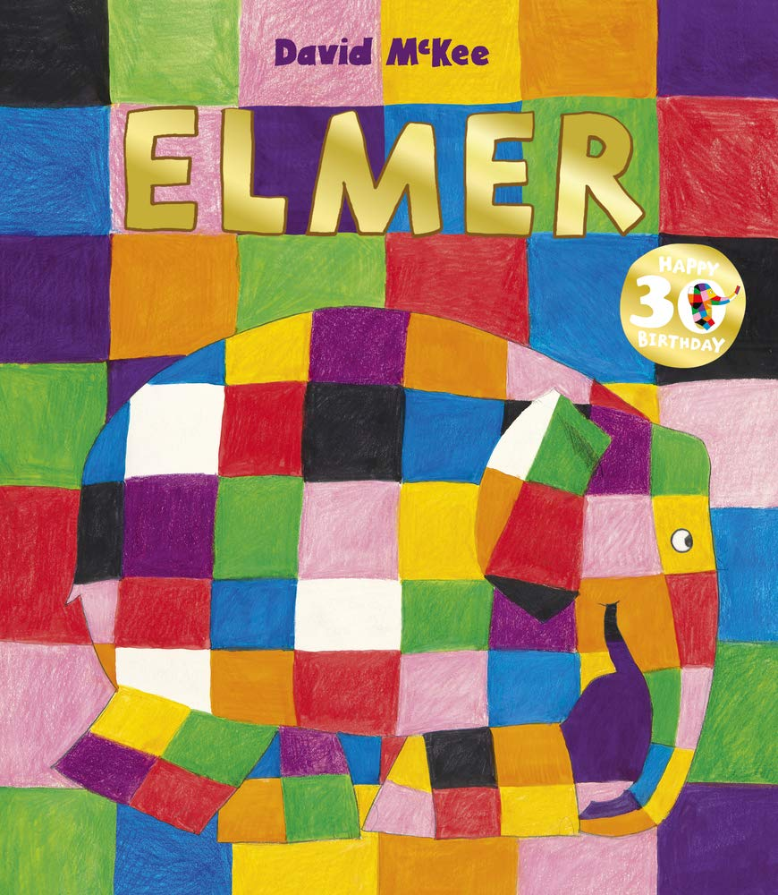
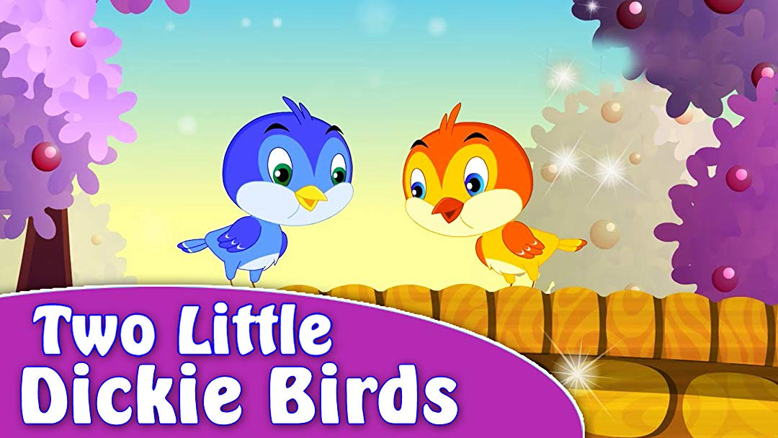
Stories and Rhymes
There is a big focus on using stories and rhymes that feature the particular number we are learning about. These stories and rhymes are woven through all of the children’s learning.

Slide 7
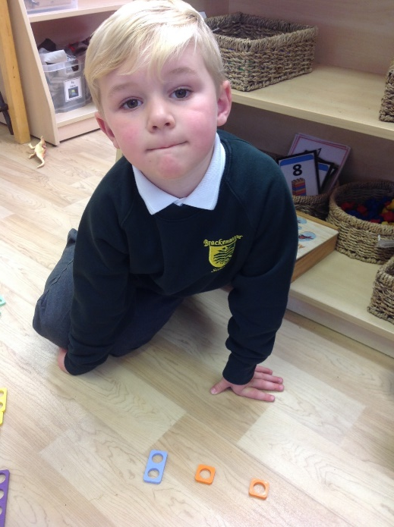
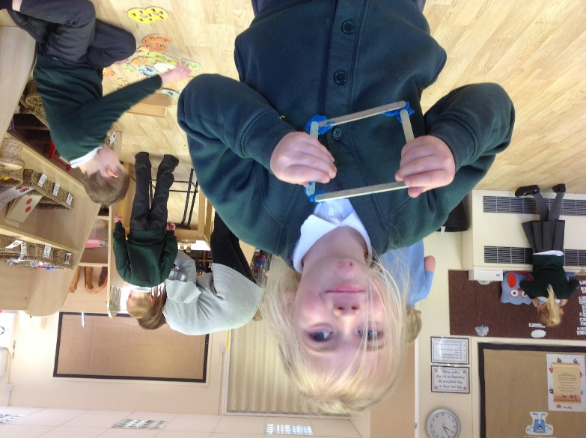
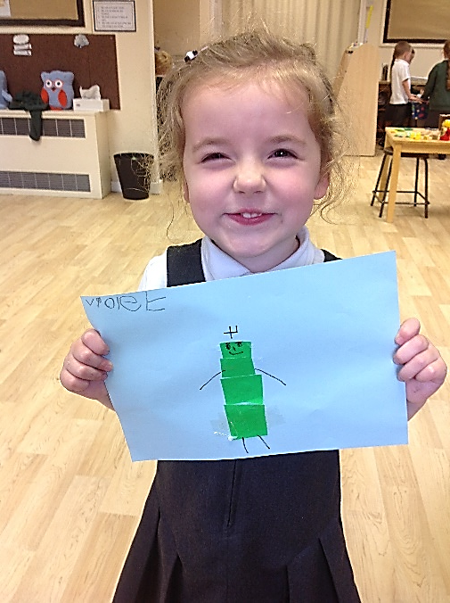
Maths in Continuous Provision
We are continuously looking at where we can enrich the maths in our provision – this is very often led by the children.
We find the children are so excited about the maths they are learning due to the investigative and problem solving approach that is completely accessible to all children.
We aim to provide plenty of mathematical learning opportunities that are LOW THREAT, HIGH CHALLENGE!

Slide 8
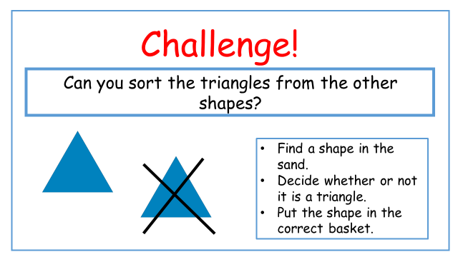
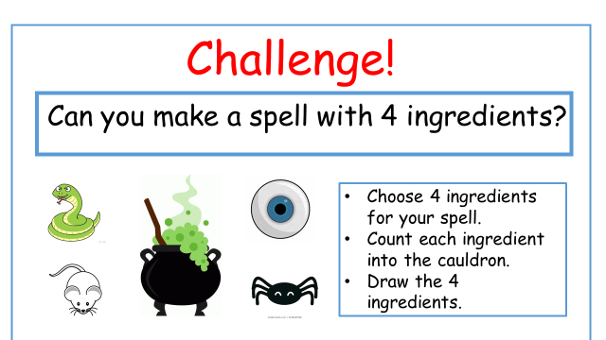
Challenges
Then we have our maths challenges for when we want to guide the children’s learning in a specific way.
These are introduced and modelled to the children so that they are then able to access them independently.
These will become differentiated as the children become used to doing them and as we progress through the year.

Slide 9
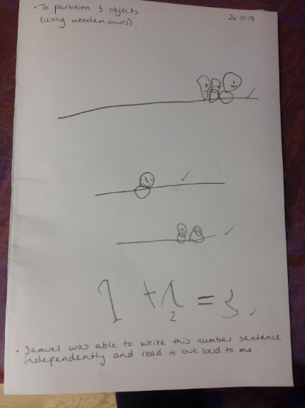
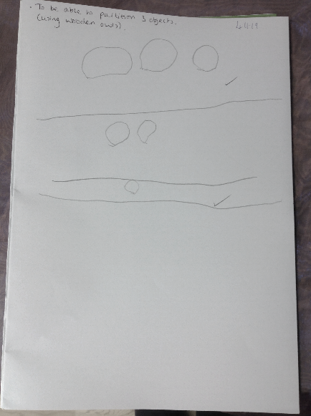
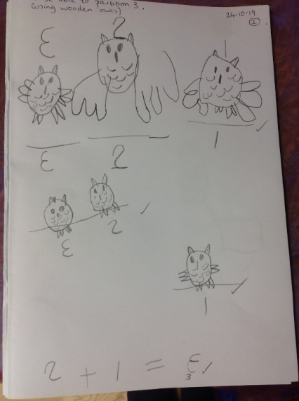
Maths Journals
Concrete
Pictorial
Abstract
Children will always start new learning using real objects (concrete) and then they are given the opportunity to “draw” their learning in their maths journals (pictorial) in a way that is meaningful to them.
Children then move towards recording their learning using written numerals and mathematical symbols (abstract).
The children’s maths journals provide us with a really effective picture of each child’s understanding and what their next steps need to be.

Slide 10
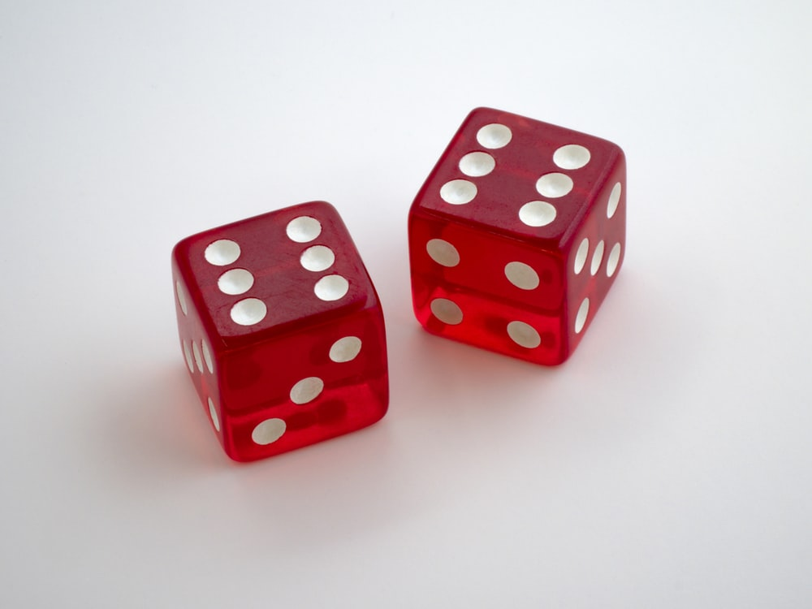
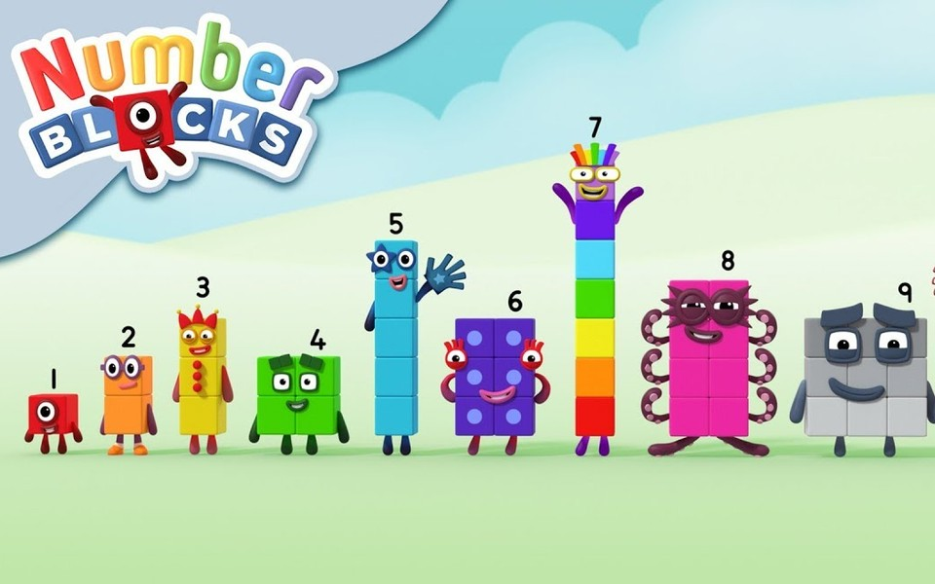
How can you help at home?
Count with your child – steps up the stairs, place settings at the table
Play games with a dice and encourage your child to say how many spots without counting
Look for different representations of numbers in the environment – door numbers, car registrations, buses
Watch Numberblocks on Cbeebies
Read books with Maths concepts e.g. The Very Hungry Caterpillar, What’s the Time Mr Wolf?
Deliberately make mistakes – miss numbers out when counting, muddle numbers up when ordering them

